Slide 1


SMART INDIA HACKATHON 2026
Problem Statement ID –26125
Problem Statement Title - Blockchain-Based Secure Platform for Identity, Access Control, and Digital Asset Management
Theme - Blockchain & Cybersecurity
PS Category - Software
Team ID – GLAS51
Team Name - TrustMesh

Slide 2
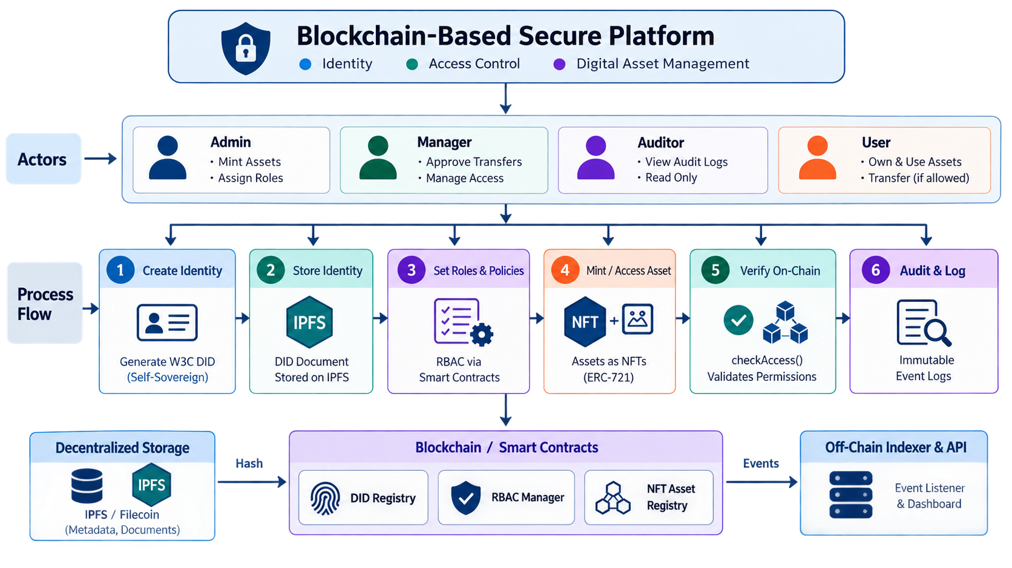
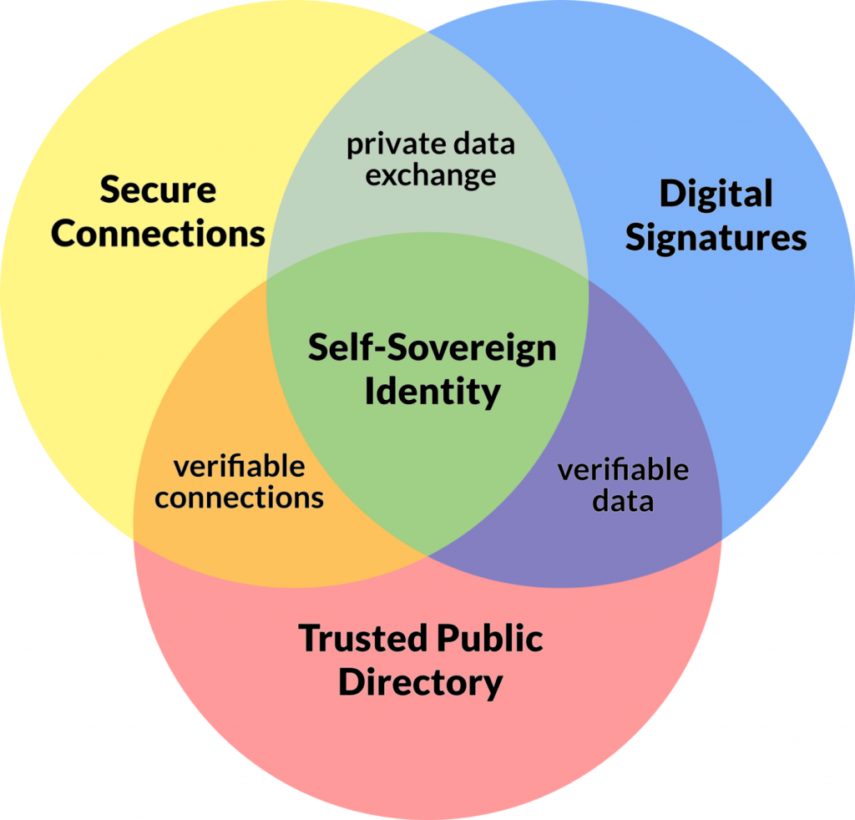
TrustMesh - A Blockchain-Based Trust Layer for Identity, Access Control & Digital Assets
TrustMesh
The Problem
The Proposed Solution
Impact and Innovation
Centralized identity systems create security risks and single points of failure.
Identity theft & unauthorized access are difficult to prevent and verify.
Digital assets and access rights are fragmented across disconnected systems.
Ownership, access rights & authenticity are difficult to track and vulnerable to tampering.
A reusable Trust Layer connects applications to blockchain-backed identity, policy enforcement, asset ownership and audit evidence..
DID-based identity provides a cryptographically verifiable identity layer for participating applications.
NFT-based digital assets provide verifiable ownership and controlled transfers through smart contracts.
PolicyEngine enforces access decisions on-chain, while AuditLogger records trust-relevant actions as verifiable evidence..
Reduces dependence on application-specific authorization by introducing a common trust layer.
Blockchain-backed asset records make ownership and authorized transfers verifiable.
Smart-contract enforcement prevents unauthorized access and permission bypass.
Generalized Policy Engine supports NFTs, documents, APIs and physical access without redeployment.
Multi-tenant architecture allows multiple organizations to securely share the same platform.
Guardian-based social recovery enables secure credential recovery with time-lock protection.

Slide 3

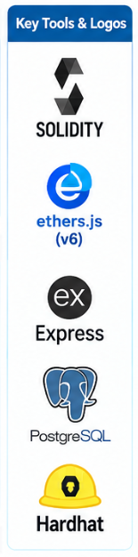

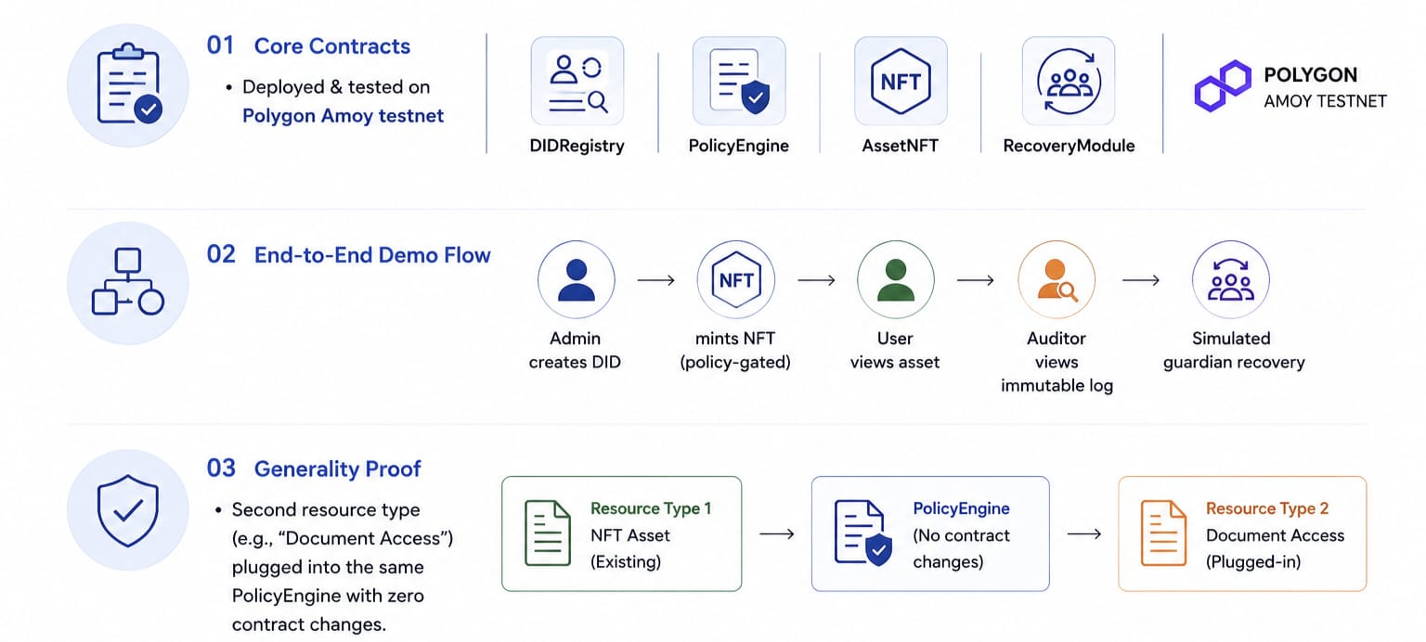
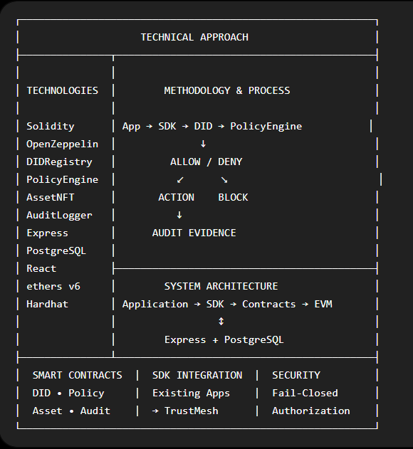
TECHNICAL APPROACH
TrustMesh
Methodology & Process
Technologies Used
SMART CONTRACTS
Solidity+OpenZepplein AccessControl,ERC-721
User
Registration
DID generated client-side
(keys never leave device
DID Document pinned to IPFS
hash stored in DIDRegistry.sol
Admin defines Roles & Resources via no-code UI
written to PolicyEngine.sol
Admin mints NFT/grants resource access
checkAccess()
validates RBAC on-chain
Every action emits an event
indexed off-chain shown in Auditor dashbaord
If key lost->Guardian -based recovery
(M-of-N signatures+48-72hr timeclock)
BLOCK CHAIN
Polygon for MVP/demo
Hyperledger Fabric for production
IDENTITY
W3C DID(did:ethr/did:key,did-jwt)
DECENTRALIZED STORAGE
IPFS via Pinata/Web3.Storage Metadata & documents
System-Architecture
Prototype Plan
BACKEND
Node.js + Express/NestJS,Off-chain event indexer
FRONTEND
React+ethers.js/NestJS Off-chain event indexer
DEV/TEST
Hardhat Local Chain,testing & deployment

Slide 4










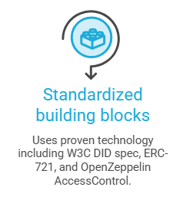
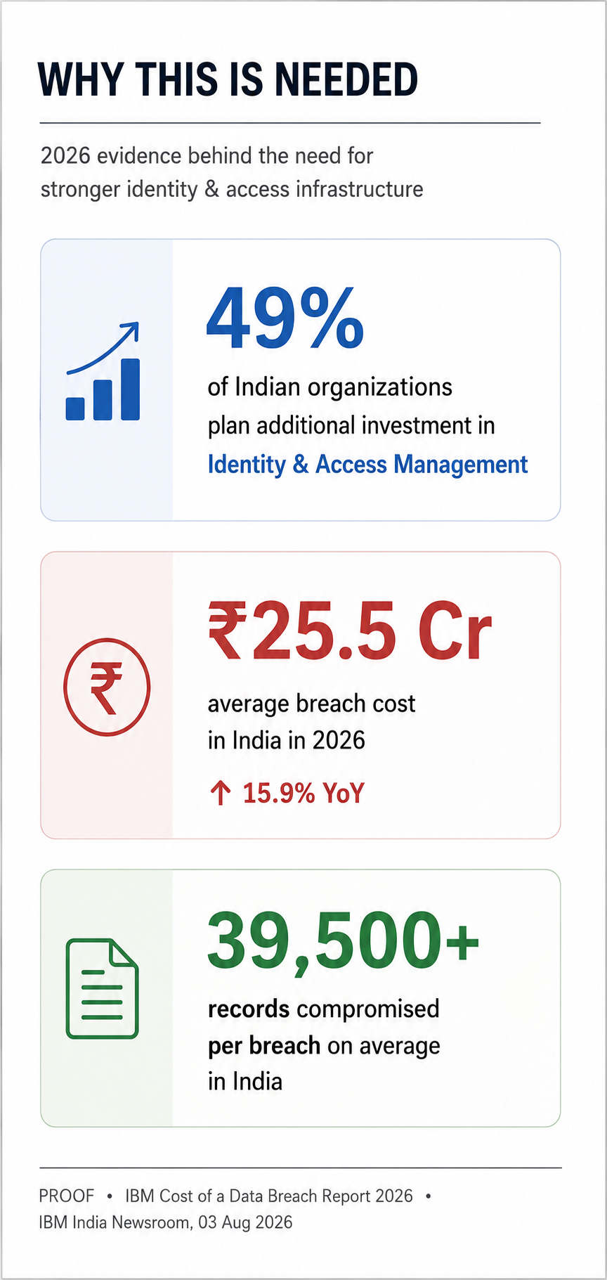
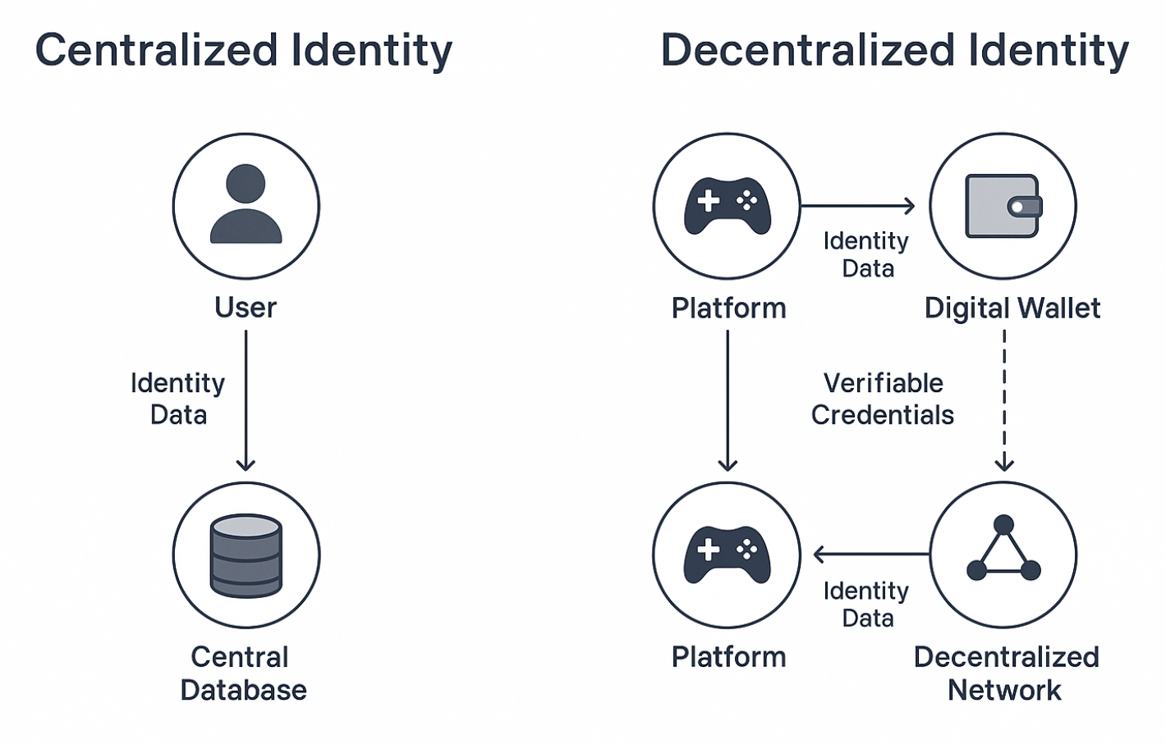
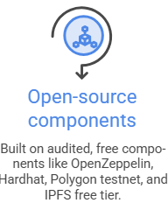
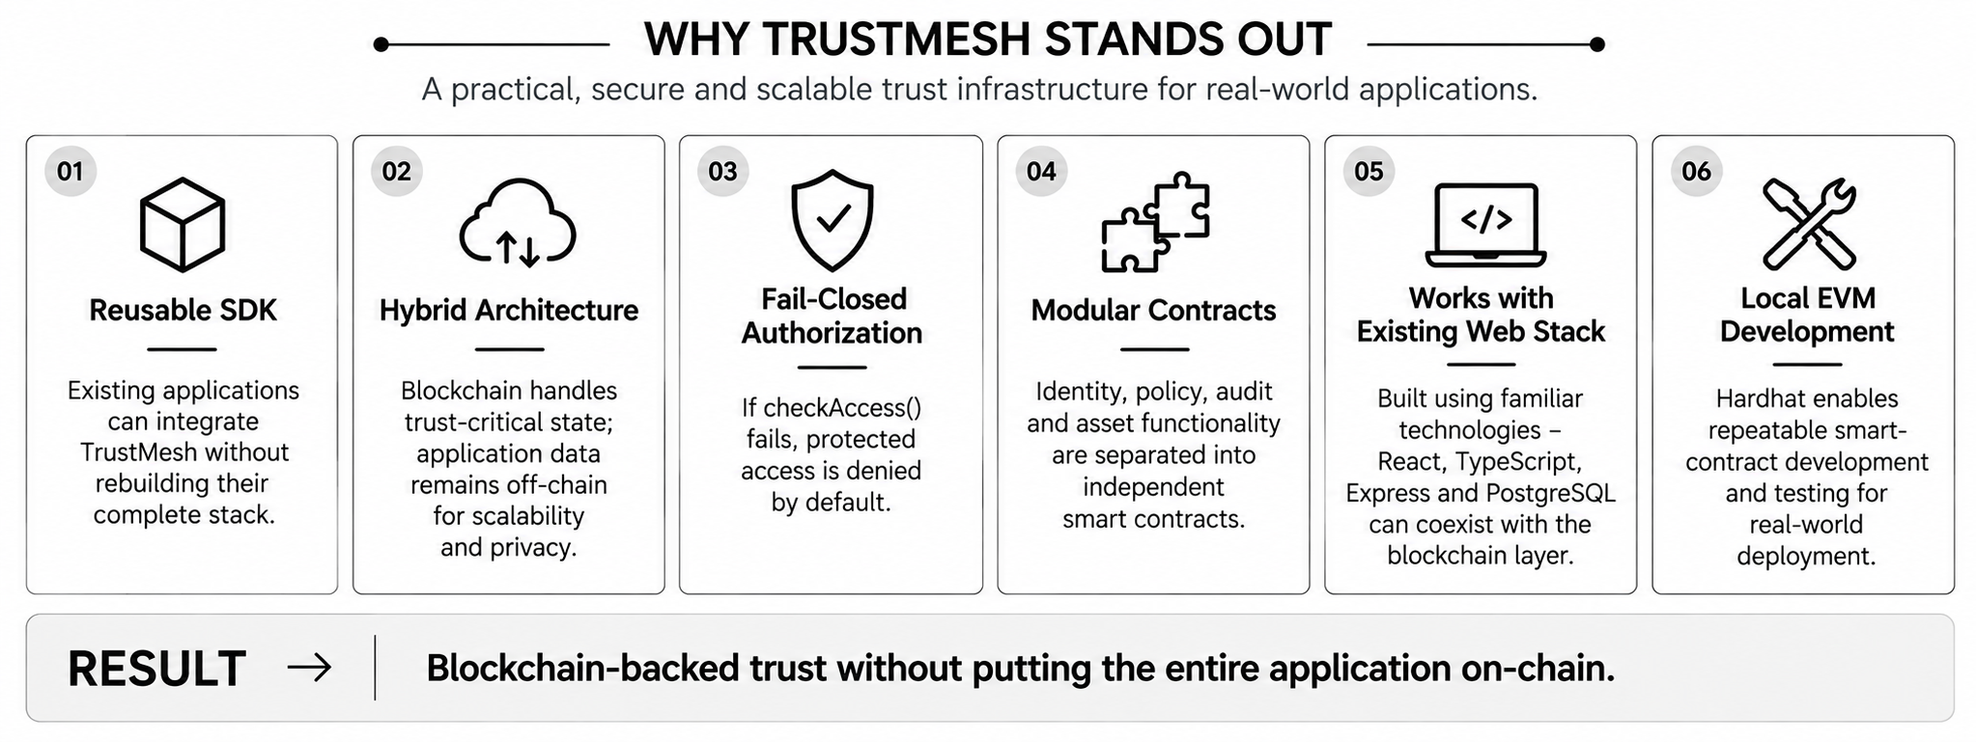
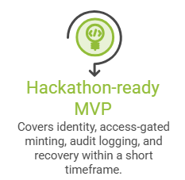
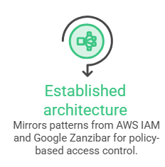
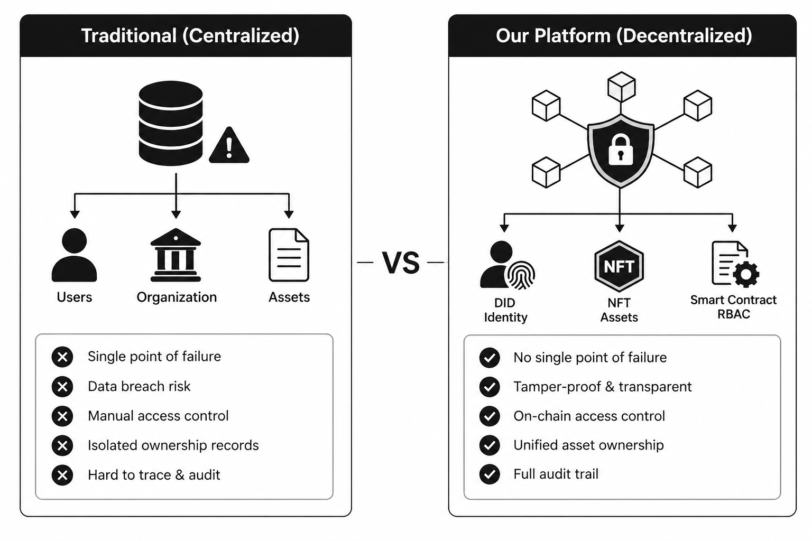
FEASIBILITY AND VIABILITY
TrustMesh
Potential Challenges & Risks
Strategies to Overcome Challenges
Lost private keys causing identity loss, with no central reset option available.
Guardian‑based recovery with institutional fallback ensures identity restoration even if keys are lost.
High gas costs on public chains, making frequent operations expensive and limiting scalability.
L2 or permissioned deployment reduces transaction costs and scales more efficiently for enterprises.
Immutable data conflicting with DPDP Act requirements, creating compliance issues with erasure rights.
Off‑chain encrypted PII with only hashes on‑chain enables lawful erasure while preserving integrity.
Admin key compromise enabling fake asset minting or unauthorized role assignment in the system.
Multisig and hardware wallets strengthen admin security, preventing single‑key compromise risks.
Low crypto‑literacy creating friction in onboarding, as seed phrases and fees confuse mainstream users.
Account abstraction (ERC‑4337) simplifies onboarding by hiding blockchain complexity and sponsoring gas.
Feasibility Analysis

Slide 5
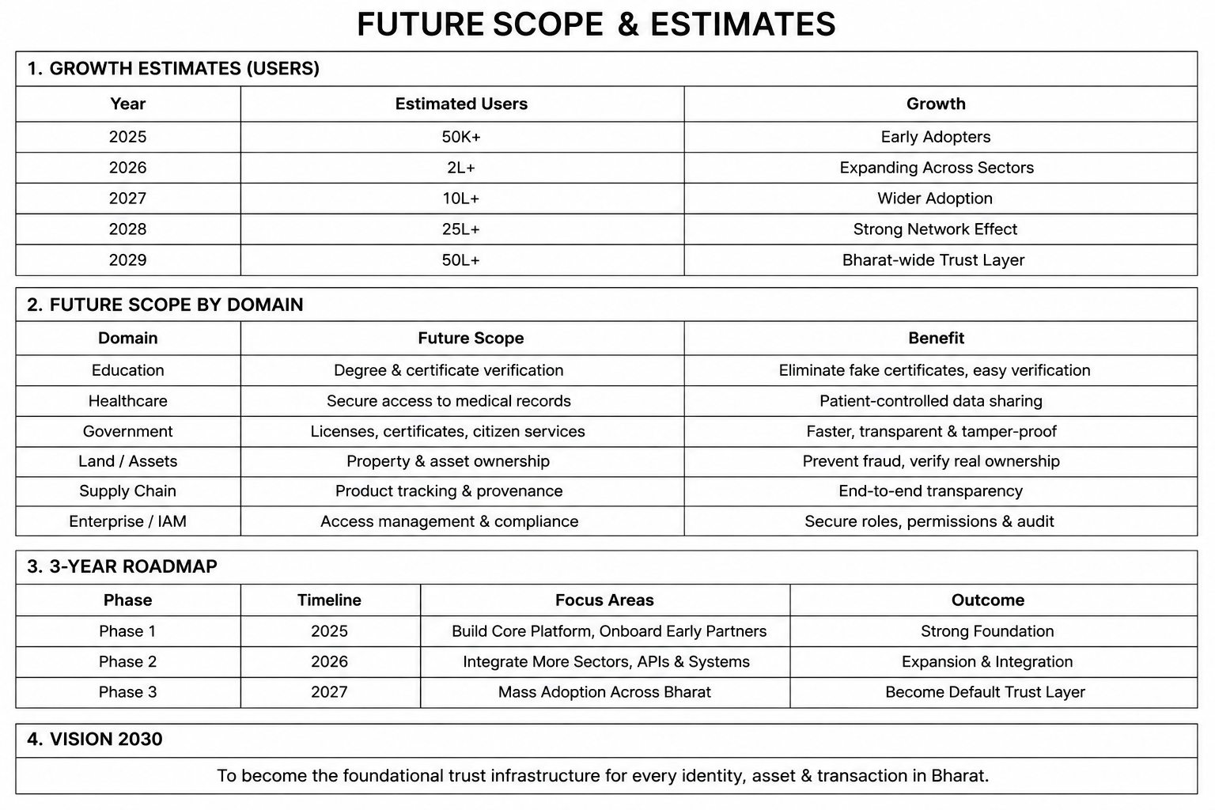
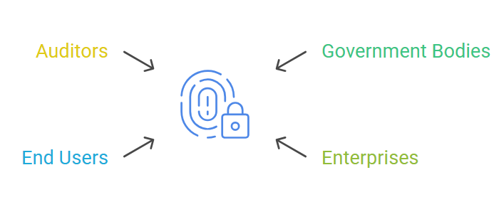
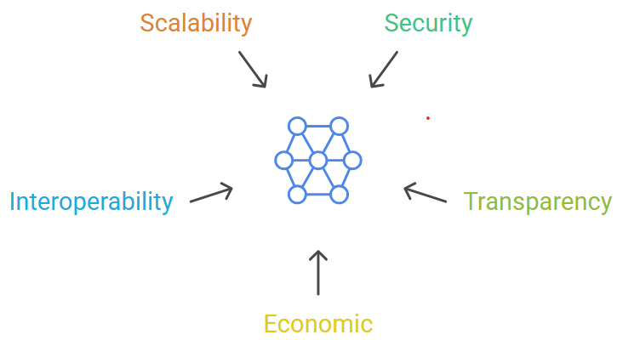
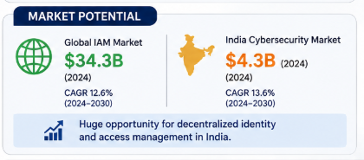
IMPACT AND BENEFITS
TrustMesh
Government
Tamper‑proof identity & record systems (land, certificates, licenses) → prevents forgery and unauthorized changes by keeping records immutable and verifiable.
Economic
Cuts fraud losses & manual verification costs → reduces operational overhead while improving trust in digital transactions.
Enterprises
Unified IAM + asset custody + compliance logging. → Eliminates siloed systems, reducing fraud and simplifying audits with one secure platform.
Scalability
One policy engine serving multiple domains (education, healthcare, supply chain, land records) → maximizes impact with minimal redeployment effort.
Citizens
Self‑sovereign identity, no lockouts or breaches → ensures individuals control their digital identity, protecting against misuse and central lockouts.
Interoperability
Portable W3C DID identities across platforms → allows seamless use of one identity across multiple apps and ecosystems.
Auditors
Real‑time, verifiable audit trails for accountability → provides indisputable evidence instantly, cutting disputes and speeding compliance checks.
Security
Eliminates the single point of failure in centralized IAM → ensures identities and assets remain safe even if one node is compromised.

Slide 6
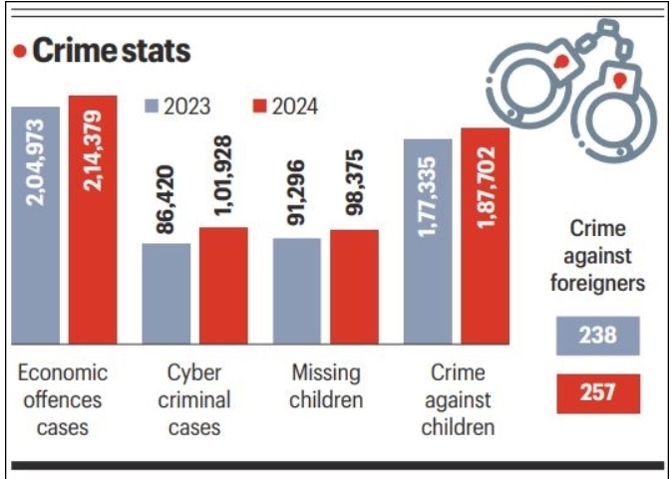
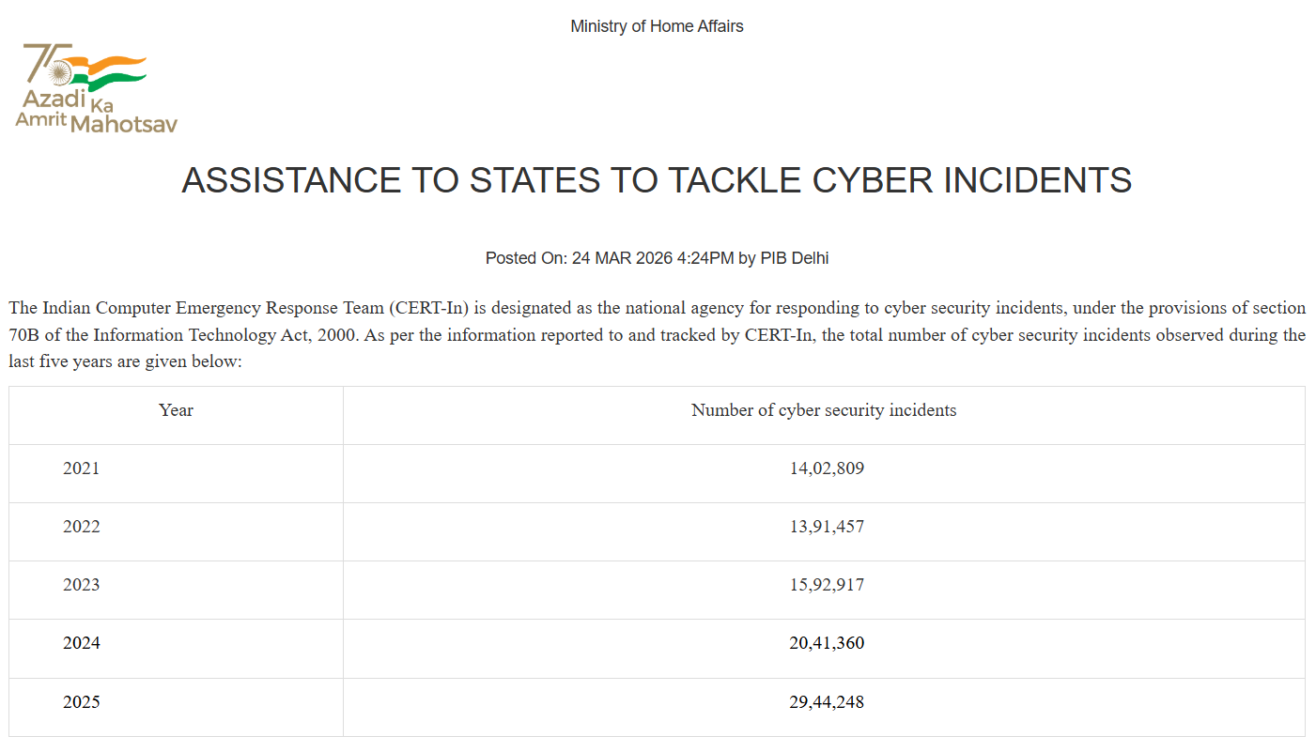
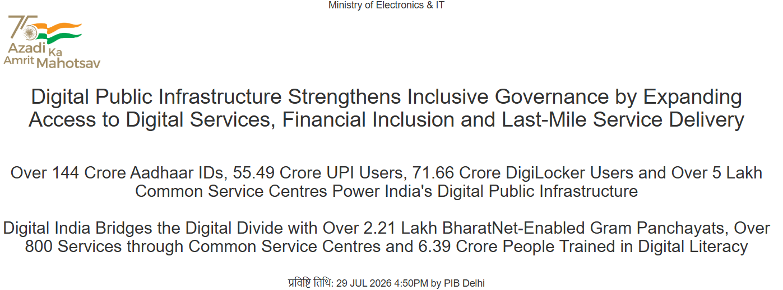
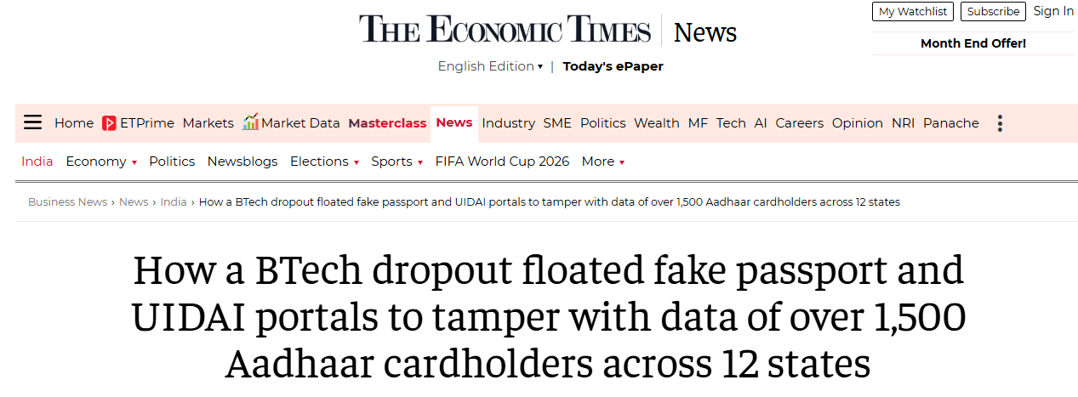
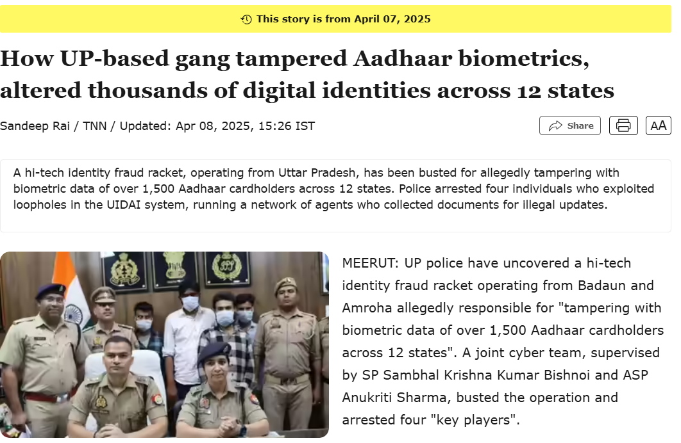
RESEARCH AND REFERENCES
TrustMesh
W3C Decentralized Identifiers v1.1 –Candidate Rec, 2026 –Defines global, self‑sovereign digital identities without central control.
OpenZeppelin Contracts (AccessControl, ERC-721) –Audited smart‑contract library for RBAC and NFT standards.
1.
2.
3.
4.
India’s DPDP Act, 2023 –Privacy law enforcing consent, user rights, and strict data compliance.
Hyperledger Fabric Docs –Enterprise‑grade permissioned blockchain for secure, modular networks.

